Slide 1
Arts Management
A NEW GENERATION OF ARTS MANAGERS
THE VISUAL AND PERFORMING ARTS
Arts Managers--those who would coordinate the people; engage the community; develop and sustain the audiences; influence the politics; foster the development; track the finances; plan artistic programming
Lu Zhang
Scholar
Work
Association
The Most Influential Scholars/Professionals in Arts Management Area
The Most Influential Books in Arts Management Area
The Most Famous associations in Arts Management Area
November 19th, 2014
Lu Zhang
lzhang15@masonlive.gmu.edu

Slide 2
1
SOMETHING ABOUT AMGT
Arts Management, different from Arts Administration, focuses on the alignment of many resources required when develop arts organizations: to birth, sustain, and further develop. Arts management helps to prepare candidates that can afford of coordinating with both internal and external alignment for arts organizations, to advance the management of all aspects of the arts, to nurture the artist and audience as well as other art forms. By completing the MA program of study, students get trained with skills in financial and budgetary management, strategic management and entrepreneurship, and public relations. The professional training for arts managers with skills in the private and public arts sectors also responses to the growing need of graduates with applied arts management skills in the fast developing arts market of China.
For more information please visit website:
artsmanagement.gmu.com
Lu Zhang
lzhang15@masonlive.gmu.edu

Slide 3
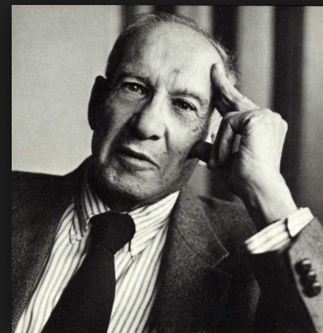
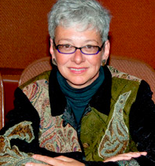
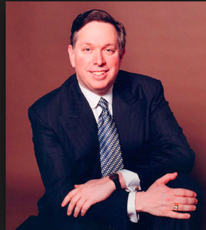
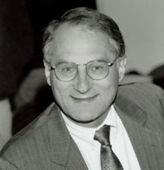
2
MEET THE SCHOLARS／PROFESSIONALS
Peter F. Drucker
Tobie S. Stein
Drucker has influenced leaders from organizations across all sectors of society.
Stein is the director of the graduate program in in performing arts management at Brooklyn College.
Micheal M. Kaiser
Richard Chait
Kaiser was the President of the Kennedy Center from 2001 to 2014. He has a great reputation for being an arts administrator and for being an effective leader in arts management area.
Chait is a professor emeritus at the Harvard Graduate School of Education and Chair of COACHE's National Advisory Council, studying the management and governance of colleges and universities
.
Lu Zhang
lzhang15@masonlive.gmu.edu

Slide 4
3
THE FAMOUS ASSOCIATIONS
IAMA
Arts Reach
NAPAMA
The International Artist Managers’ Association
IAMA - is the only worldwide association for classical music artist managements. It is dedicated to serving all its members' needs including Affiliate and Group members and it strives to raise professional standards in the business of music.
The Association of Arts Management, Marketing & Development Professionals.
Arts Reach is the association that supports leading arts professionals who are committed to “Advancing Arts Revenue Growth Together.”
North American Performing Arts Managers and Agents
NAPAMA is a not-for-profit service organization founded in 1979, and dedicated to promoting the professionalism of its members and the vitality of the performing arts
.
Lu Zhang
lzhang15@masonlive.gmu.edu

Slide 5
4
IMPORTANT WORKS
1.Stein, T., & Bathhurst, J. (2008). Performing Arts Management: A Handbook of Professional Practices. Allworth Press.
2.Powell, W., & Steinberg, R. (2006). The Nonprofit Sector: A Research Handbook (2nd ed.). Yale University Press.
3.Drucker, P. (2008). The Five Most Important Questions You Will Even Ask About Your Organization. Jossey-Bass.
4.Chait, R., Ryan, W., & Taylor, B. (2004). Govenance as Leadership: Reframing the Work of Nonprofit Boards (1st ed.). Wiley.
5.Kaiser, Michael. (2010). Leading Roles: 50 Questions Every Arts Board Should Ask. Brandeis University.
6.Lakey, B. (2010). Board Fundamentals : Understanding Roles in Nonprofit Governance (2nd ed.). BoardSource.
7.Drucker, P. (2008). The Essential Drucker. Harper Business.
Lu Zhang
lzhang15@masonlive.gmu.edu

Slide 6
5
CURRENT TOPICS
In Media
Atlanta Symphony lockout
In mid-August, the Atlanta Symphony Orchestra struck a peculiar bargain in an attempt of alleviating what would grow to become $20 million in the next year. The musicians had been locked out of their workplace since September 7th, when was the day that the contracts expired, to November 8th. Such kind of lockout happened in ASO two years ago. The ASO musicians and management finally agree to a four-year collective bargaining agreement.
Lu Zhang
lzhang15@masonlive.gmu.edu

Slide 7
6
CURRENT TOPICS
In Media
Baumol’s Cost Disease
Cost Disease is a phenomenon described by Baumol and Bowen in 1965. This theory points out the problem in arts organization area that there is no productivity gained associated with the rehearse and perform work whereas the costs increase overtime and the earned revenue growth is limited by market forces, thus arts organizations are pushed to be aggressively pursuit of contributed income just to balance the budget. Cost disease is a frequent topic in arts administration/management area.
Lu Zhang
lzhang15@masonlive.gmu.edu

Slide 8
7
CURRENT TOPICS
In Research
Definition of the Nonprofit Sector
Nonprofit Arts Organization✪
The Nonprofit Sector
Arts Management
For-profit Arts Organization
Lu Zhang
lzhang15@masonlive.gmu.edu

Slide 9
9
CURRENT TOPICS
The Nonprofit Sector in the U.S.
Internal Revenue Service Data Book, 2009
Lu Zhang
lzhang15@masonlive.gmu.edu

Slide 10
8
CURRENT TOPICS
The Nonprofit Sector in the U.S.
Cross-Nationally
The Nonprofit Sector in China
Lu Zhang
lzhang15@masonlive.gmu.edu

Slide 11
10
CURRENT TOPICS
Definition of the Nonprofit Sector
the Johns Hopkins Comparative Nonprofit Sector Project (JHCNSP)
MY TOPIC:
The nonprofit sector in China: A discussion of contextual characteristics and challenges
Lu Zhang
lzhang15@masonlive.gmu.edu

Slide 12
Thank you…
Scholar
Work
Association
The Most Influential Scholars/Professionals in Arts Management Area
The Most Influential Books in Arts Management Area
The Most Famous associations in Arts Management Area
November 19th, 2014
Lu Zhang
lzhang15@masonlive.gmu.edu

